Slide 1
SQL Selecting.JOIN

Slide 2
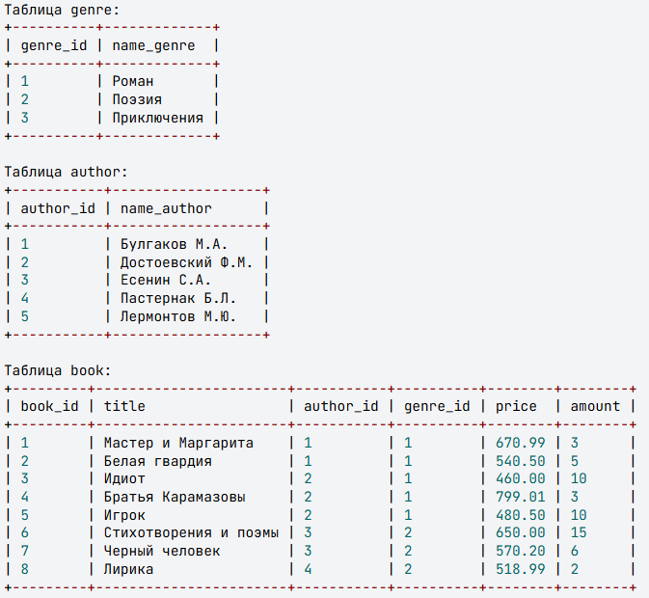
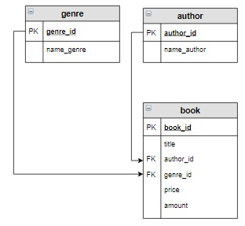
INNER JOIN

Slide 3
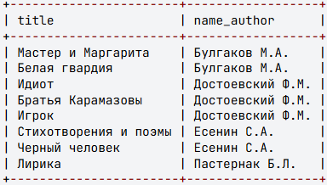
INNER JOIN
The INNER JOIN operator combines two tables. The order of the tables in the operator is not important, as the operator is symmetric.
SELECT ...
FROM table_1
INNER JOIN table_2
ON condition ...
The query result is formed as follows:
Each row from one table is matched with every row from the second table;
The join condition is checked for the resulting "joined" row;
If the condition is true, the corresponding "joined" row is added to the result table.
Example
Retrieve the titles of books and their authors.
SELECT title, name_author
FROM author
INNER JOIN book
ON author.author_id = book.author_id;
Since the author_id fields in the book and author tables have the same name, it is necessary to use their fully qualified names in queries (book.author_id and author.author_id).
In this query, the primary table author is joined with the dependent table book using the key column author.author_id and the foreign key book.author_id. The result set includes all rows where the values in these columns match. In other words, the rows from the dependent table book are supplemented with the last names and initials of the authors from the author table.

Slide 4
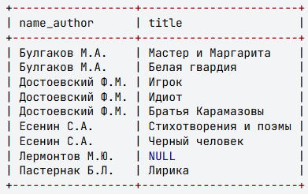
Outer Joins LEFT and RIGHT OUTER JOIN
The LEFT OUTER JOIN operator (can be abbreviated as LEFT JOIN) combines two tables. The order of tables in the operator matters because the operator is not symmetric.
SELECT ...
FROM таблица_1
LEFT JOIN таблица_2
ON условие ...
The query result is formed as follows:
The result includes the inner join (INNER JOIN) of the first and second tables according to the specified condition.
Then, the result is supplemented with those records from the first table that were not included in the inner join in step 1. For such records, the corresponding fields of the second table are filled with NULL values.
The RIGHT JOIN operates similarly, except in step 2 the roles of the first and second tables are swapped.
Example
Retrieve the titles of all books by each author. If some authors currently have no books in stock, display NULL instead of the book title.
SELECT name_author, title
FROM author
LEFT JOIN book
ON author.author_id = book.author_id
ORDER BY name_author;
Since there are no books by Lermontov in the book table, NULL appears next to this author's name.

Slide 5
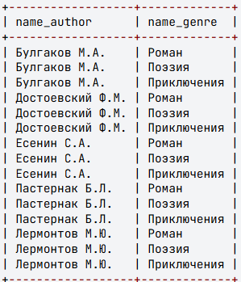
Cross Join CROSS JOIN
The cross join operator, also known as the Cartesian product CROSS JOIN (in a query, a comma can be used between tables instead of the keywords), combines two tables. The order of the tables in the operator is not important, as the operator is symmetric. Its structure is:
SELECT
...
FROM
table_1 CROSS JOIN table_2
...
or
SELECT
...
FROM
table_1, table_2
...
The query result is formed as follows: each row from one table is joined with every row from the other table, resulting in all possible combinations of rows from the two tables.
For example, the query:
SELECT name_author, name_genre
FROM author, genre;
will assign every possible genre from the genre table to each author from the author table.

Slide 6
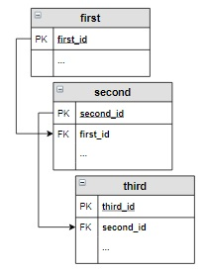
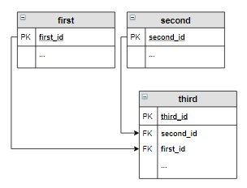
Queries for Selecting Data from Multiple Tables
A SELECT query can retrieve data from two or more database tables. The tables must be logically related to each other. For each pair of tables included in the query, a join operator must be specified. The most common type is the inner join INNER JOIN, so we will use it in the examples.
Suppose the tables are related as follows:
Then the SELECT query for these tables would look like:
SELECT ...
FROM first
INNER JOIN second ON first.first_id = second.first_id
INNER JOIN third ON second.second_id = third.second_id ...
If the tables are related like this:
Then the SELECT query would look like this:
SELECT ... FROM
first
INNER JOIN third ON first.first_id = third.first_id
INNER JOIN second ON third.second_id = second.second_id ...
In this case, it's recommended to write the table joins sequentially, "in a circular pattern": first → third → second.

Slide 7
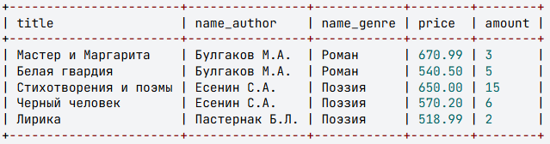
Queries for Selecting Data from Multiple Tables
Example
Retrieve information about books, their authors, and genres where the price falls within the range of 500 to 700 rubles, inclusive.
SELECT title, name_author, name_genre, price, amount
FROM author
INNER JOIN book ON author.author_id = book.author_id
INNER JOIN genre ON genre.genre_id = book.genre_id
WHERE price BETWEEN 500 AND 700;

Slide 8
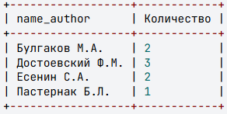
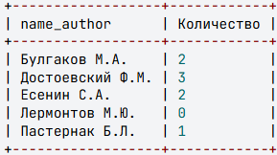
Queries for Multiple Tables with Grouping
Group functions in queries can be used across multiple tables with different types of joins.
Example
Display the number of distinct books for each author. Sort the information in alphabetical order by authors' last names.
SELECT name_author, count(title) AS Количество
FROM author
INNER JOIN book on author.author_id = book.author_id
GROUP BY name_author
ORDER BY name_author;
When using INNER JOIN, we cannot see that Lermontov's books are not in stock, though they might potentially be available. To include author Lermontov in the results, we need to change the table join type.
SELECT name_author, count(title) AS Количество
FROM author
LEFT JOIN book on author.author_id = book.author_id
GROUP BY name_author
ORDER BY name_author;

